Slide 1





Modern Education Society’s Wadia College Of Engineering
WEBVERSE 2026
NATIONAL HACKATHON
Build . Break . Innovate
TITLE PAGE
Problem Statement Title: -
Adaptive Risk-Based Authentication Using Machine Learning
Team ID: -
35
Team Name (Registered on Unstop): -
Culers
Parth Popli
Team Leader Name: -
Anuj Deshpande
Athrava Wani
Pranav Bilare
Team Members: -
Pimpri Chinnchwad College of Engineering
College / Institution Name: -
01

Slide 2
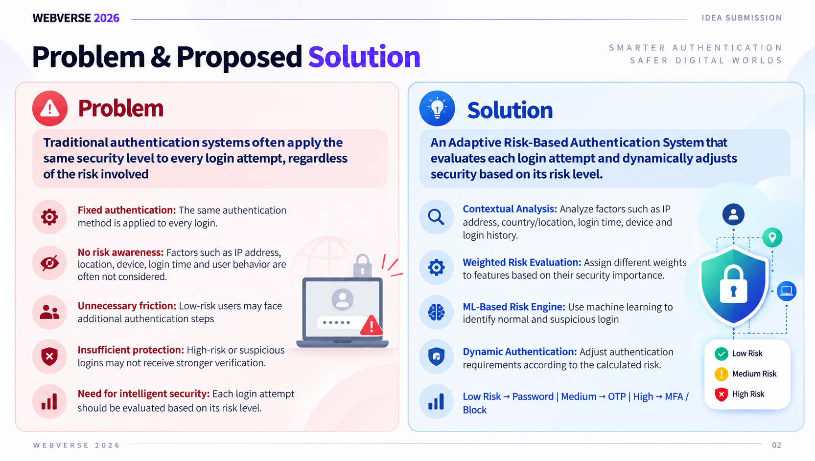
WEBVERSE 2026
IDEA SUBMISSION
Problem & Propesed Solution
Problem
Solution
Traditional authentication systems often apply the same security level to every login attempt, regardless of the risk involved
An Adaptive Risk-Based Authentication System that evaluates each login attempt and dynamically adjusts security based on its risk level.
Fixed authentication: The same authentication method is applied to every login.
Contextual Analysis: Analyze factors such as IP address, country/location, login time, device and login history.
No risk awareness: Factors such as IP address, location, device, login time and user behavior are often not considered.
Weighted Risk Evaluation: Assign different weights to features based on their security importance.
Unnecessary friction: Low-risk users may face additional authentication steps
ML-Based Risk Engine: Use machine learning to identify normal and suspicious login
Insufficient protection: High-risk or suspicious logins may not receive stronger verification.
Dynamic Authentication: Adjust authentication requirements according to the calculated risk.
Need for intelligent security: Each login attempt should be evaluated based on its risk level.
Low Risk → Password | Medium → OTP | High → MFA / Block
02

Slide 3
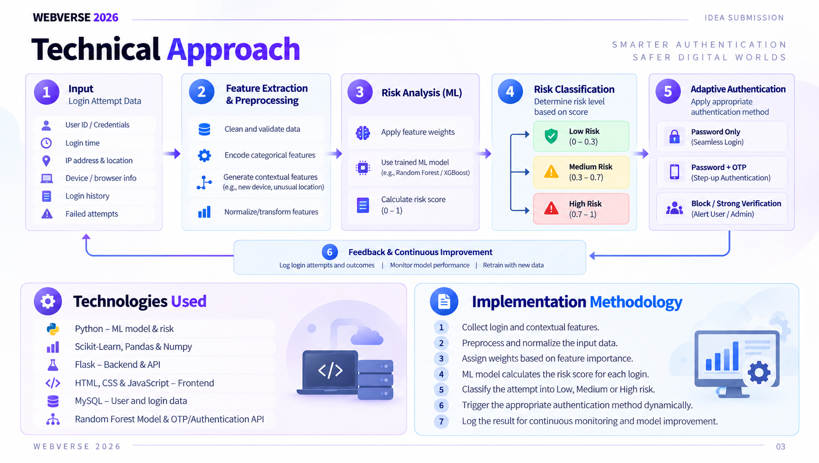
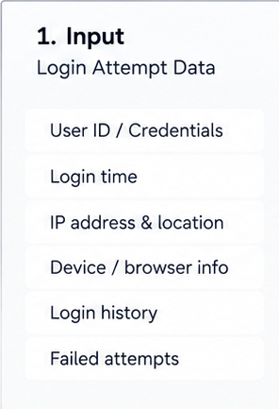
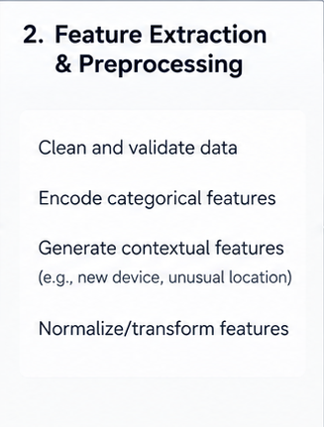
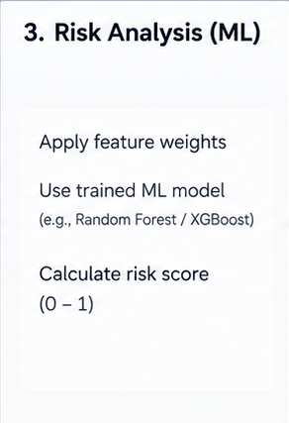
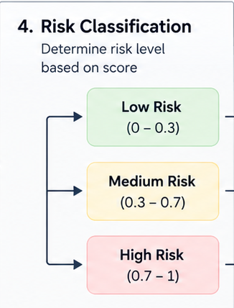
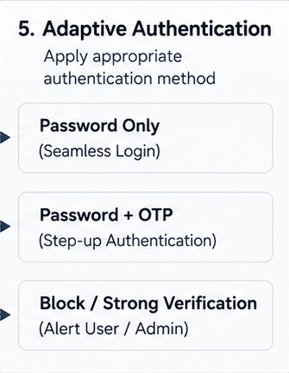
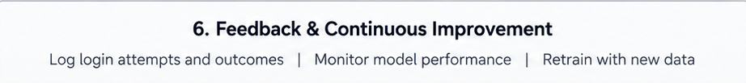
WEBVERSE 2026
IDEA SUBMISSION
Technical Approach
TECHNOLOGIES USED
IMPLEMENTATION METHODOLOGY
Python — ML model & risk
  Collect login and contextual features.
Scikit-Learn, Pandas & Numpy
  Preprocess and normalize the input data.
  Assign weights based on feature importance.
  ML model calculates the risk score for each login.
  Classify the attempt into Low, Medium or High risk.
  Trigger the appropriate authentication method dynamically.
  Log the result for continuous monitoring and model improvement.
Flask – Backend & API
HTML, CSS & JavaScript – Frontend
MySQL – User and login data
Random Forest Model & OTP/Authentication API
03

Slide 4
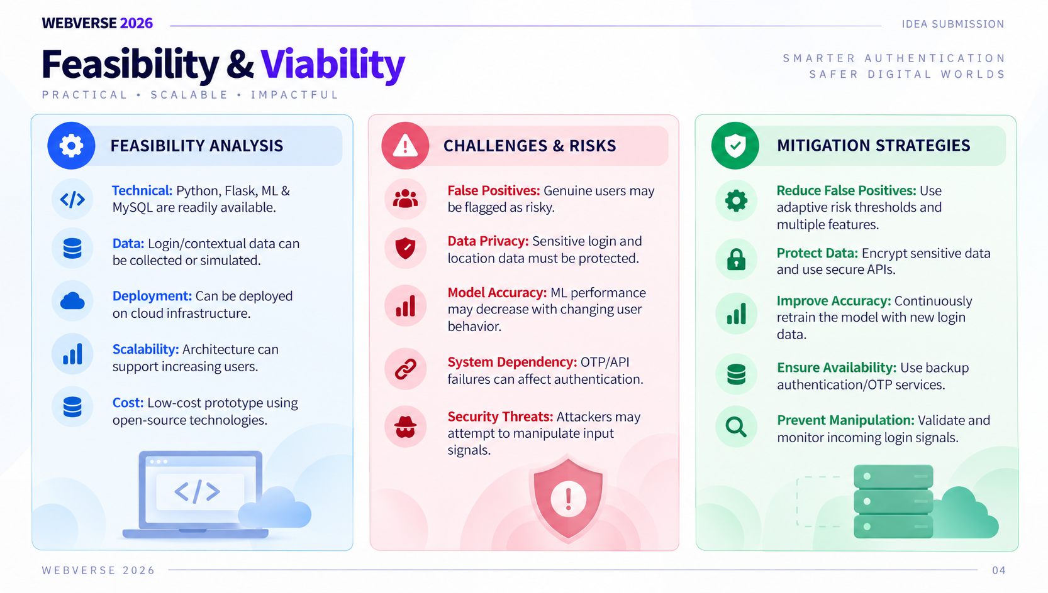
WEBVERSE 2026
IDEA SUBMISSION
Feasibility & Viability
FEASIBILITY ANALYSIS
CHALLENGES & RISKS
MITIGATION STRATEGIES
  Technical: Python, Flask, ML & MySQL are readily available.
  Data: Login/contextual data can be collected or simulated.
  Deployment: Can be deployed on cloud infrastructure.
  Scalability: Architecture can support increasing users.
  Cost: Low-cost prototype using open-source technologies.
  False Positives: Genuine users may be flagged as risky.
  Data Privacy: Sensitive login and location data must be protected.
  Model Accuracy: ML performance may decrease with changing user behavior.
  System Dependency: OTP/API failures can affect authentication.
  Security Threats: Attackers may attempt to manipulate input signals.
  Reduce False Positives: Use adaptive risk thresholds and multiple features.
  Protect Data: Encrypt sensitive data and use secure APIs.
  Improve Accuracy: Continuously retrain the model with new login data.
  Ensure Availability: Use backup authentication/OTP services.
  Prevent Manipulation: Validate and monitor incoming login signals.
04

Slide 5
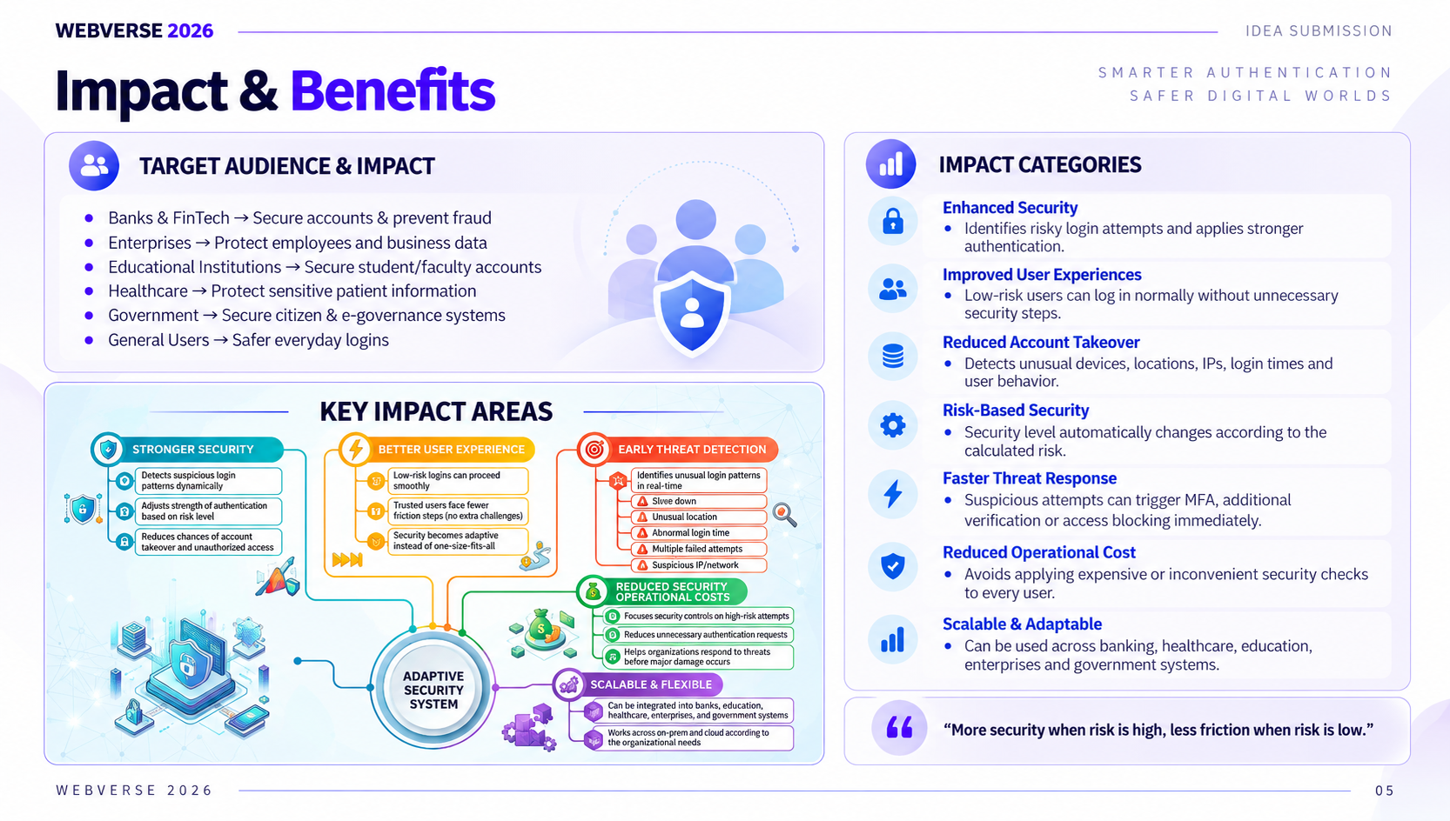
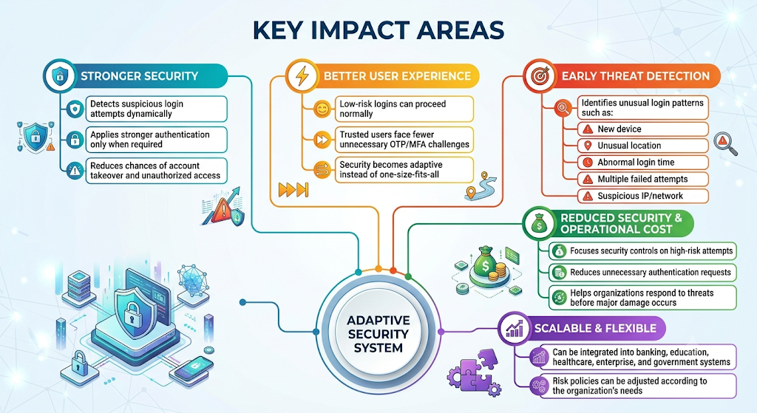
WEBVERSE 2026
IDEA SUBMISSION
Impact & Benefits
TARGET AUDIENCE & IMPACT
IMPACT CATEGORIES
  Banks & FinTech → Secure accounts & prevent fraud
  Enterprises → Protect employees and business data
  Educational Institutions → Secure student/faculty accounts
  Healthcare → Protect sensitive patient information
  Government → Secure citizen & e-governance systems
  General Users → Safer everyday logins
Enhanced Security
  Identifies risky login attempts and applies stronger
authentication.
Improved User Experience
  Low-risk users can log in normally without unnecessary security steps.
Reduced Account Takeover
  Detects unusual devices, locations, IPs, login times and user behavior.
Risk-Based Security
  Security level automatically changes according to the calculated risk.
Faster Threat Response
  Suspicious attempts can trigger MFA, additional verification or access blocking immediately.
Reduced Operational Cost
  Avoids applying expensive or inconvenient security checks to every user.
Scalable & Adaptable
  Can be used across banking, healthcare, education, enterprises and government systems.
“More security when risk is high, less friction when risk is low.”
05

Slide 6
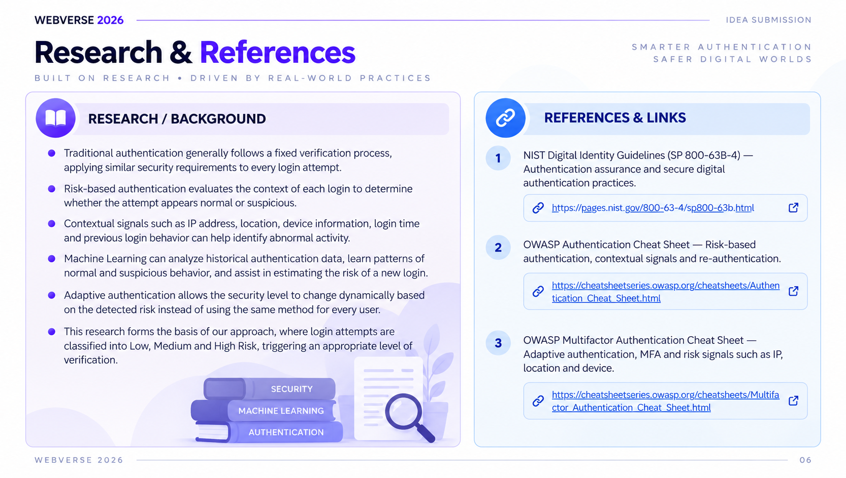
WEBVERSE 2026
IDEA SUBMISSION
Research & References
RESEARCH / BACKGROUND
REFERENCES & LINKS
  Traditional authentication generally follows a fixed verification process, applying similar security requirements to every login attempt.
  Risk-based authentication evaluates the context of each login to determine whether the attempt appears normal or suspicious.
  Contextual signals such as IP address, location, device information, login time and previous login behavior can help identify abnormal activity.
  Machine Learning can analyze historical authentication data, learn patterns of normal and suspicious behavior, and assist in estimating the risk of a new login.
  Adaptive authentication allows the security level to change dynamically based on the detected risk instead of using the same method for every user.
  This research forms the basis of our approach, where login attempts are classified into Low, Medium and High Risk, triggering an appropriate level of verification.
1. NIST Digital Identity Guidelines (SP 800-63B-4) — Authentication assurance and secure digital authentication practices.
https://pages.nist.gov/800-63-4/sp800-63b.html
2. OWASP Authentication Cheat Sheet — Risk-based authentication, contextual signals and re-authentication.
https://cheatsheetseries.owasp.org/cheatsheets/Authentication_Cheat_Sheet.html
3. OWASP Multifactor Authentication Cheat Sheet — Adaptive authentication, MFA and risk signals such as IP, location and device.
https://cheatsheetseries.owasp.org/cheatsheets/Multifactor_Authentication_Cheat_Sheet.html
06

